Slide 1
BUSINESS DATA MANAGEMENT PROJECT DATA ANALYSIS OF ‘SREE SURIYAN’- SILK SAREES MANUFACTURING COMPANY
DEVADHARSHINI
ROLL NO: 22F1000106​

Slide 2
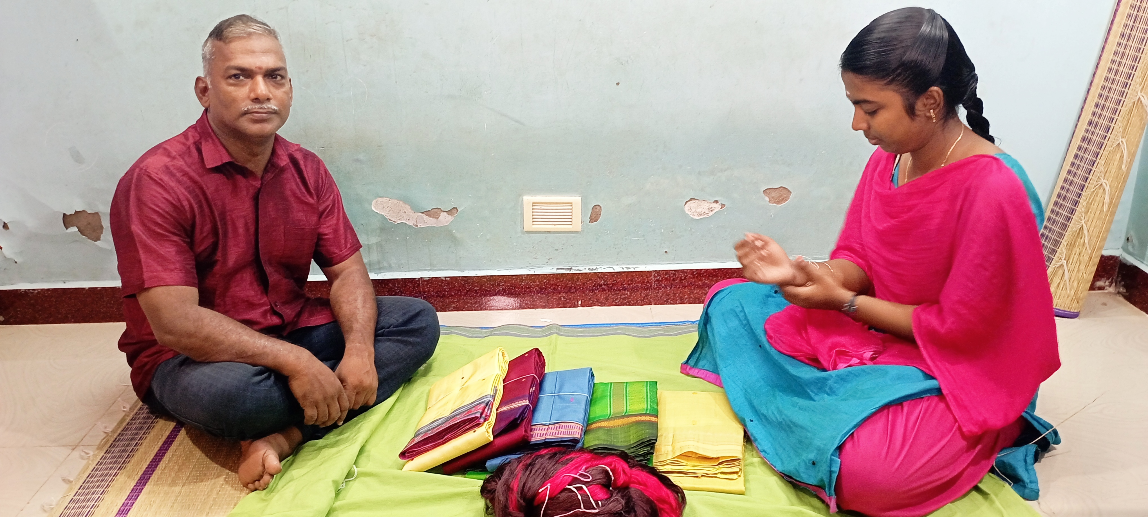
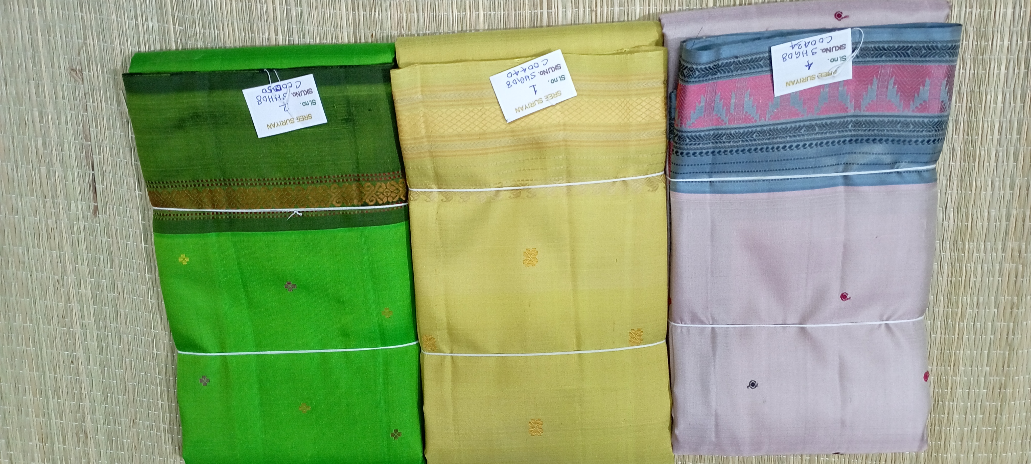
ORGANIZATION BACKGROUND
Name of the Organisation: “SREE SURIYAN”
‘SREE SURIYAN’ is a silk saris manufacturing company. The organization was formed in the year 2020 by Mr.T.V.Santhanam.
It is a Business to Business based company (B2B).
Number of workers: Ten (Accounts manager, seven weavers, two saree-folders).
Number of meetings with the owner of the organisation is totally three.
To request data for analysis.
To enter the data into excel sheets.
To get proof of originality of the data.

Slide 3
PROBLEM STATEMENTS
What are the monthly trends in sales?
Which type of saree has the highest and lowest demand?
How are the sarees distributed across months?
How to increase the production of saris?

Slide 4
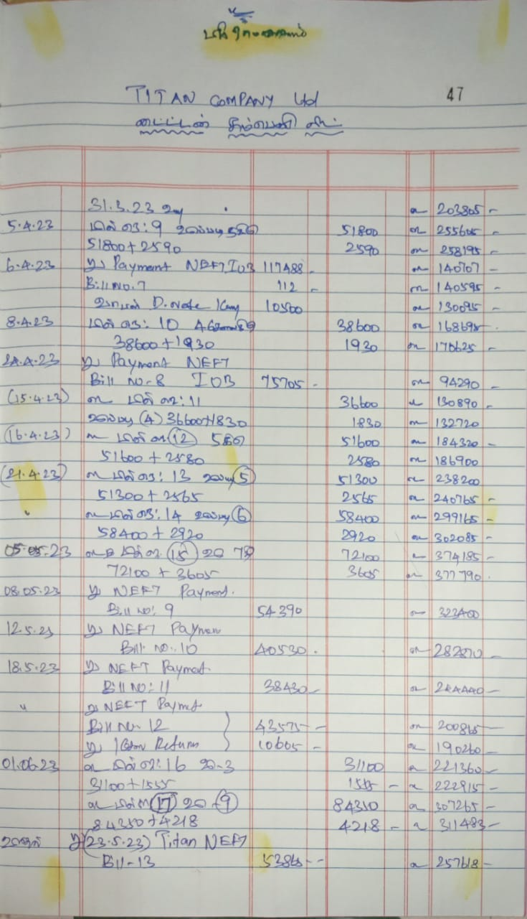
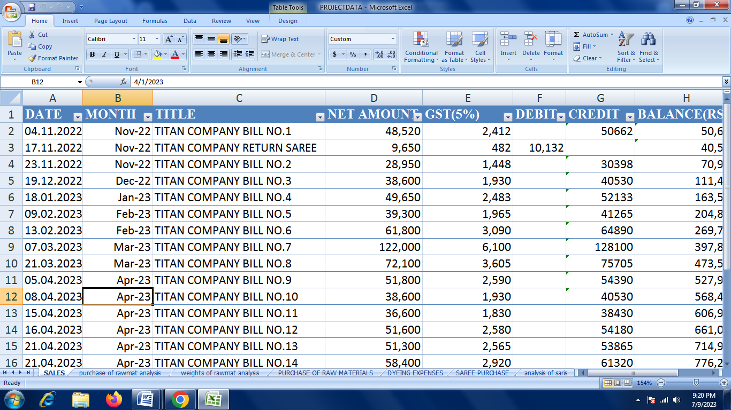
DATA COLLECTION
The data collected from organization are ‘Sales data’, ‘Purchase data’, ‘Expenses data’, ‘Saree types data’ and labours’ salaries data.
The sales, saree types and purchase data are collected from bills and ledger notes. The Expenses data is collected from bills.
Excel sheets were made with these data for analysis. The whole data was collected for 8 months.

Slide 5
ANALYSIS OF SALES DATA
The sales data includes Bill numbers, Date of bills, Title of bill, Net amount, GST, Total amounts.
This data was filtered month wise using ‘pivot table’ in excel and monthly trend in sales was found.
A bar chart was prepared for monthly trend analysis in sales.

Slide 6
ANALYSIS ON PURCHASE OF RAW MATERIALS DATA
The purchase of raw material data includes raw materials such as jari, warp, weft and raw silk.
It consists of date, month, title, bill number, particulars, weight of raw materials and amounts.
The data were filtered month wise and weight wise. This provided the analysis of raw material data.
A pie and bar chart was created for analysis.

Slide 7
ANALYSIS OF EXPENSES DATA
The expenses used for dyeing the warp and weft is given in the expense data.
It consists of date, month, title and amount of expenses.
A line graph was created for monthly trend analysis of expense data.

Slide 8
ANALYSIS ON DEMAND OF SAREES
The analysis on demand of sarees is made by ‘types of sarees’ data.
The types of sarees data consists of saree types and number of sarees sold month wise.
It was filtered month wise and month wise distribution analysis was made.
A bar and pie chart was created for analysis.

Slide 9
RESULTS AND FINDINGS
From Sales data analysis, it was found that there is a large amount of sales in the month of April.
From Purchase data analysis, it was found that there is a large amount of purchase in the month of March. It also shows that weft is the only raw material purchased a lot compared to other raw materials.
From Expense data analysis, it was found that there is a lot of dying expense between the months of March and April.
From sarees types data analysis, it was found that pure jari and thread bordered saree had a lot of demand and lotus butta pallu elephant type sarees are sold in a small quantity.

Slide 10
RECOMMENDATIONS
Moreover, the profit margin of the business is low. The reason for this is there are only limited amount of sarees are produced.
Less production is due to few number of handloom weavers. This can be increased by creating awareness about the benefits of handloom with the public who are jobless.
The revenue used for purchasing the raw material can be minimized by purchasing the raw material when the rate is minimum.
To increase the profit rate every month, the payment should be bought beforehand for the sold sarees. So, instead of using the profit margin, the payment received every month can be used to purchase raw materials.

Slide 11
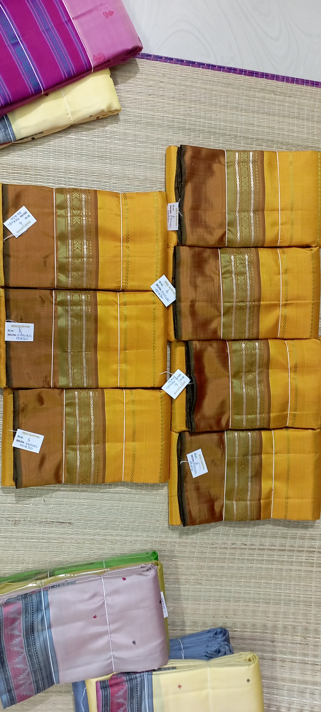
Thank you

